Slide 1
Getting Started: Entity Resolution
05, Feb, 2020
Macêdo, Crislânio
Dieb, Felipe
Menezes, Clairton

Slide 2
Outline
Motivation
Record Deduplication & Record Linkage
Advantages
Hands on
Conclusion
References

Slide 3
What is Entity Resolution
Entity Resolution is the task of disambiguating manifestations of real world entities in various records or mentions by linking and grouping.
For example, there could be different ways of addressing the same person in text, different addresses for businesses, or photos of a particular object.
This clearly has many applications, particularly in government and public health data, web search, comparison shopping, law enforcement, and more.

Slide 4
Motivation
Real world data is inputted by people and often it's:
Not linked with related data
Incorrectly inputted because people make mistakes: type mishearing, miscalculation, misinterpretation, etc.
This causes the following problems on data:
Duplications (e.g. person appears with multiple addresses)
Bad formatting (e.g birth dates appear with multiple formats)
Inconsistencies (e.g. a person appears with multiple addresses)

Slide 5
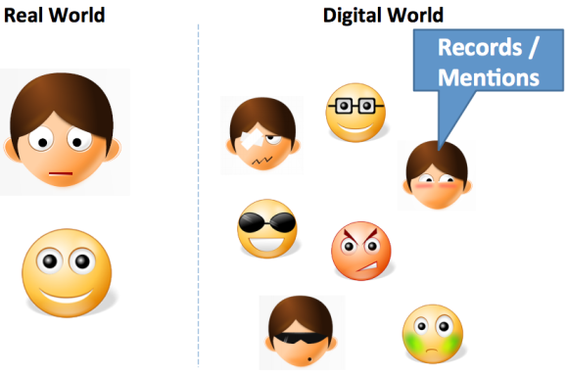
There exists in the real world entities, and in the digital world, records and mentions of those entities.

Slide 6

Data world is noisy
Databases frequently contain duplicate fields and records that refer to the same real-world entity.

Slide 7

Data world is messy
Real World

Slide 8
Record Linkage & Record Deduplication
Data Deduplication - is a technique for detecting / eliminating duplicate data in a dataset.
Record Linkage (RL) - Task of finding records in a dataset that refers to the same entity in different data sources (e.g., books websites, database), when this task refers to only one data source, it is known as Deduplication.
Canonicalization: converting data with more than one possible representation into a standard form.

Slide 9
Deduplication

Slide 10
Record Linkage
Record Linkage is also known as Data Matching, Entity Resolution etc

Slide 11
Canonicalization

Slide 12
Indexing in Record Linkage
Database A
Cleaning and Normalization
Indexing
Database B
Cleaning and Normalization
Record pair comparison
Similarity vector classification
Evaluation
Matches
Non-matches
Review

Slide 13
Dedupe.io
Dedupe is a library that uses machine learning to perform deduplication and entity resolution quickly on structured data. In addition to removing duplicate entries from within a single dataset, Dedupe can also do record linkage across disparate datasets.
How it works?
As such, Dedupe works by engaging the user in labeling the data via a command line interface, and using machine learning on the resulting training data to predict similar or matching records within unseen data. The name of this process is Active Learn.
source: https://pypi.org/project/dedupe/1.6.5/

Slide 14
Testing Out Dedupe
Getting started with Dedupe is easy, and the developers have provided a convenient repo with examples that you can use and iterate on.
To get Dedupe running, we’ll need to install unidecode, future, and dedupe.

Slide 15
The challenges
How can computers know if names are similar ?
How can computers know if similar addresses matter more or less than similar names or similar employers ?
How can computers cluster similar records quickly if there’s a lot of data?

Slide 16
Advantages
Improving data quality and integrity
Reducing costs and efforts in data acquisition
Duplicate data reduction or group analysis
Identifying records that reference the same entity across different sources.
Multiples Domains
Fraud Detection
Health systems
Enterprise business systems
Proper identification of duplicated patient information remains an arduous problem for hospitals, pharmacies and service providers.

Slide 17

Hands on

Slide 18
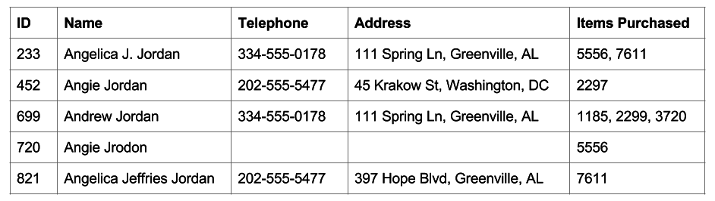
Hands on
Notes:
Let’s imagine we own an online retail business, and we are developing a new recommendation engine that mines our existing customer data to come up with good recommendations for products that our existing and new customers might like to buy.

Slide 19
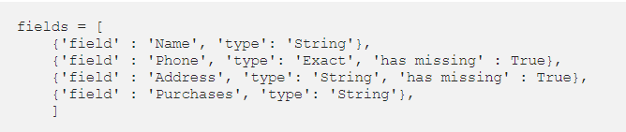
Hands on
Dedupe cleverly exploits the structure of the input data to instead compare the records field by field.
Dedupe lets the user nominate the features they believe will be most useful:
Notes:
Let’s imagine we own an online retail business, and we are developing a new recommendation engine that mines our existing customer data to come up with good recommendations for products that our existing and new customers might like to buy.

Slide 20
Hands on
Dedupe scans the data and group the data as matches, not matches, or possible matches.
These uncertainPairs are identified using a combination of blocking , affine gap distance, and active learning.

Slide 21
Hands on: Blocking
Dedupe’s method of blocking involves engineering subsets of feature vectors (these are called ‘predicates’). In the case of our people dataset above, the predicates might be things like:
the first three digits of the phone number
the full name
the first five characters of the name
a random 4-gram within the city name
Hamming Distance: https://www.tutorialspoint.com/what-is-hamming-distance

Slide 22
Hands on: Affine gap
Use a distance metric like a variation on Hamming distance that makes subsequent consecutive deletions or insertions cheaper.
Hands on: Active Learning
Uses all the processes above then generate an iteratively result for each element of the data.
Dedupe is a command line application that will prompt the user to engage in active learning by showing pairs of entities and asking if they are the same or different.
Hamming Distance: https://www.tutorialspoint.com/what-is-hamming-distance
Dedupe types: https://docs.dedupe.io/en/latest/Variable-definition.html

Slide 23
Conclusion
Finding duplicates or matching data when you don't have primary keys is one of the biggest challenges in preparing data for data science.
https://developers.google.com/knowledge-graph

Slide 24
Conclusion
Entity Resolution is becoming an increasingly important task as linked data grows, and the requirement for graph based reasoning extends beyond theoretical applications.
With the advent of big data computations, this need has become even more prevalent.
https://developers.google.com/knowledge-graph
https://youtu.be/mmQl6VGvX-c

Slide 25

https://developers.google.com/knowledge-graph
https://youtu.be/mmQl6VGvX-c

Slide 26
References
[1] Linking Data for Health Services Research: A Framework and Instructional Guide [Internet]- https://www.ncbi.nlm.nih.gov/books/NBK253312/
[2] Data Linkage: The Big Picture - https://hdsr.mitpress.mit.edu/pub/8fm8lo1e
[3] Deduplicatoin & Record Linkage- https://www.kaggle.com/caesarlupum/deduping-record-linkage#Deduplication-&-Record-Linkage.
[4] 1 + 1 = 1 or Record Deduplication with Python- https://youtu.be/McsTWXeURhA
[5] Indexing Techniques for Scalable Record Linkage and Deduplication-https://pt.slideshare.net/kkpradeeban/indexing-techniques-for-scalable-record-linkage-and-deduplication
[6] Deduplication detection- https://pt.slideshare.net/kirar/tutorial-4-duplicate-detection

Slide 27
References
[7] Basics of Entity Resolution with Python and Dedupe- https://medium.com/district-data-labs/basics-of-entity-resolution-with-python-and-dedupe-bc87440b64d4
[8] A THEORY FOR RECORD LINKAGE* - https://courses.cs.washington.edu/courses/cse590q/04au/papers/Felligi69.pdf
[9] Entity Resolution for Big Data - http://www.datacommunitydc.org/blog/2013/08/entity-resolution-for-big-data
[10] Google Knowledge Graph Search API - https://developers.google.com/knowledge-graph
[10] Generate Fake Data - https://mockaroo.com/

Slide 28


